Slide 1
APPLIANCE AUTOMATION AND ACTUARORS
BASED ON IOT AND PYTHON

Slide 2
PROJECT DISCRIPTION
IN THE UPCOMING SLIDES:-
INTRODUCTION TO PROJECT AND AIM.
FRONT-END a)ARDUINO FUNCTIONALITY.
b) BLUETOOTH (hc-05).
c) USER INTERFACE.
BACK-END a)PYTHON SERIAL PROGRAMING WITH CODING.

Slide 3

2.1) BACK-END b) HOW ARDUINO IS PROGRAMMED.
c) CODING WITH SCREENSHOTS.
3) WORKING OF THE PROJECT.
4) APPLICATIONS AND ACTUATOR(SENSORS).

Slide 4
INTRODUCTION
APPLIANCE AUTOMATION project is based on arduino microcontroller programing and Python serial programing. The project is about connecting the user to access the appliances wirelessly ,more efficiently and shockfree way with bluetooth. Automation helps in connecting multiple devices at same time within a network. The arduino microcontroller has multiple functionality through which it can controller various electrical appliances as well as circuits. The bluetooth module used in the project is HC-05 through which signal is send and recived by bluetooth with python serial program working in the backend as a serial monitor for the microcontroller.The serial monitor gui is made with the pyqt5 tool to make an gui application for the front end user and easy to access.
AIM OF THE PROJECT IS TO MAKE A WIRELESS ENVIRONMENT WHICH IS BEING CONTROLLED BY A SINGLE DEVICE.

Slide 5

FRONT ENDS
ARDIUNO MICROCONTROLLER-
Arduino is an open-source electronics platform based on easy-to-use hardware and software. Arduino boards are able to read inputs - light on a sensor, a finger on a button, or a Twitter message - and turn it into an output - activating a motor, turning on an LED, publishing something online.

Slide 6
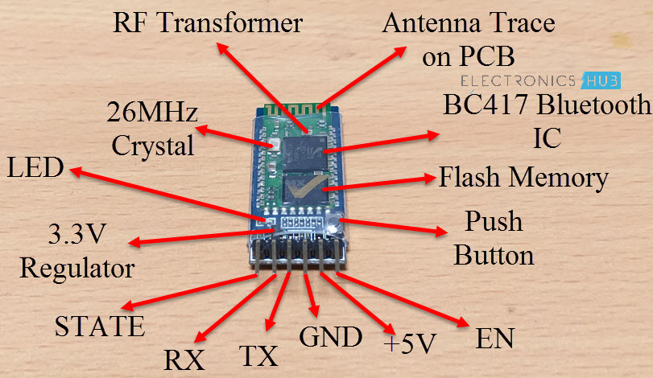
BLUETOOTH MODULE USED IN PROJECT HC-05

Slide 7
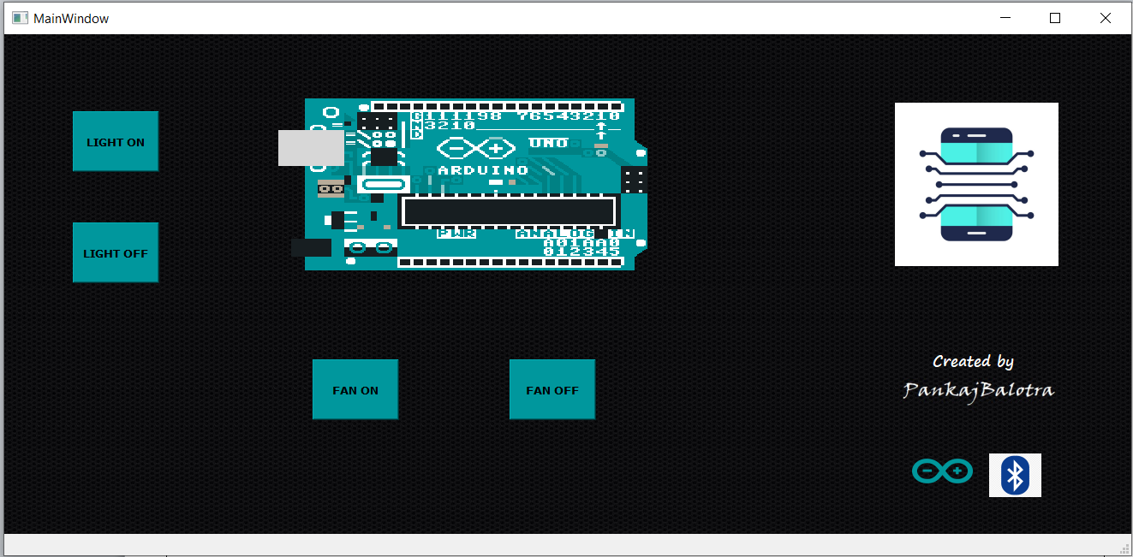
USER INTERFACE
THIS IS MY APPLICATION MAINWINDOW(GUI-PYTHON APPLICATION)

Slide 8
BACK-END OF THE PROJECT
PYTHON SERIAL PROGRAMMING-
It is used to generate a serial monitor for microcontroller which send and receive the signal for TURN_ON or TURN_OFF any appliance.
# IN ORDER TO INSTALL LIBRARY-
Installation-
This installs a package that can be used from Python (import serial). To install for all users on the system, administrator rights (root) may be required.
From PyPI
pySerial can be installed from PyPI:
python -m pip install pyserial

Slide 9
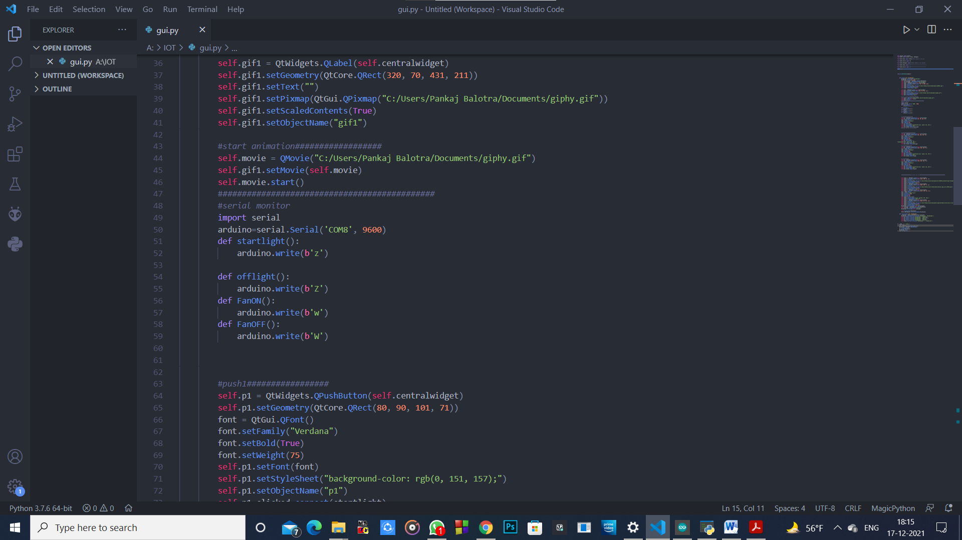
MY SCREENSHOT
THIS IS MY SERIAL MONITOR CODING TO COMMUNICATE WITH ARDIUNO AT 9600 FREQUENCY AND SPP = COM8

Slide 10
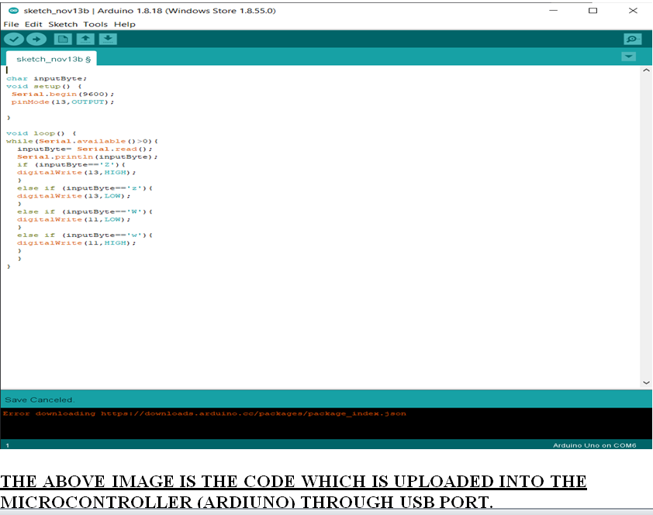
PROGRAMMING OF ARDIUNO

Slide 11
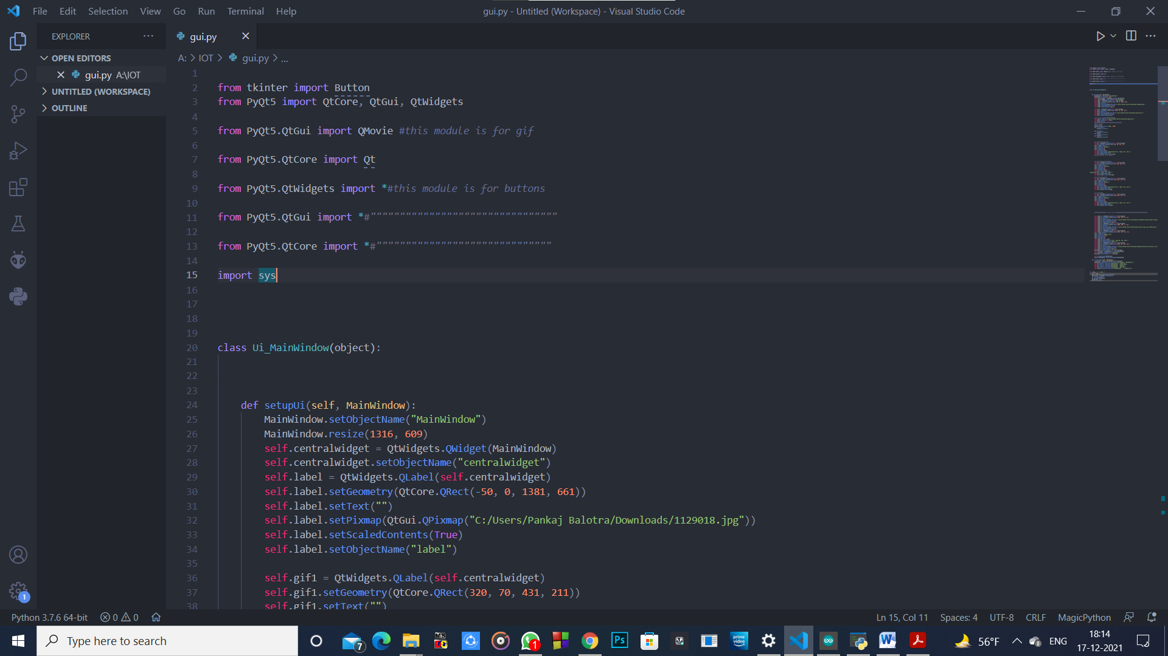
CODING WITH SCREENSHOTS

Slide 12
THESE ARE THE SERIAL COMMANDS WHICH SENDS THE SIGNAL TO THE BLUETOOTH
BY SERIAL PORT(SPP)
–COM8 AT 9600 FREQUENCY

Slide 13
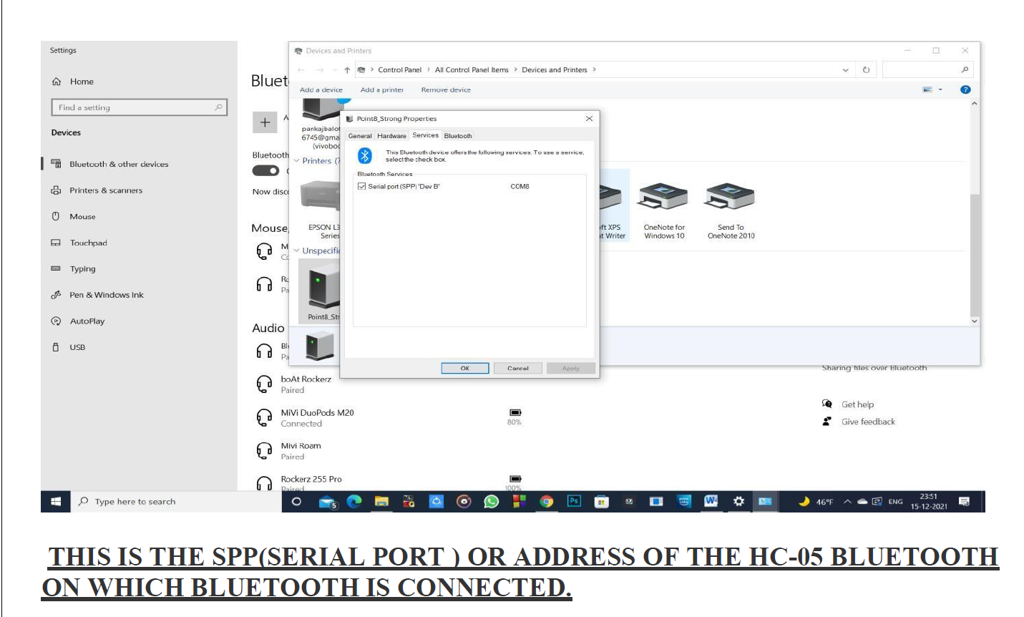

Slide 14
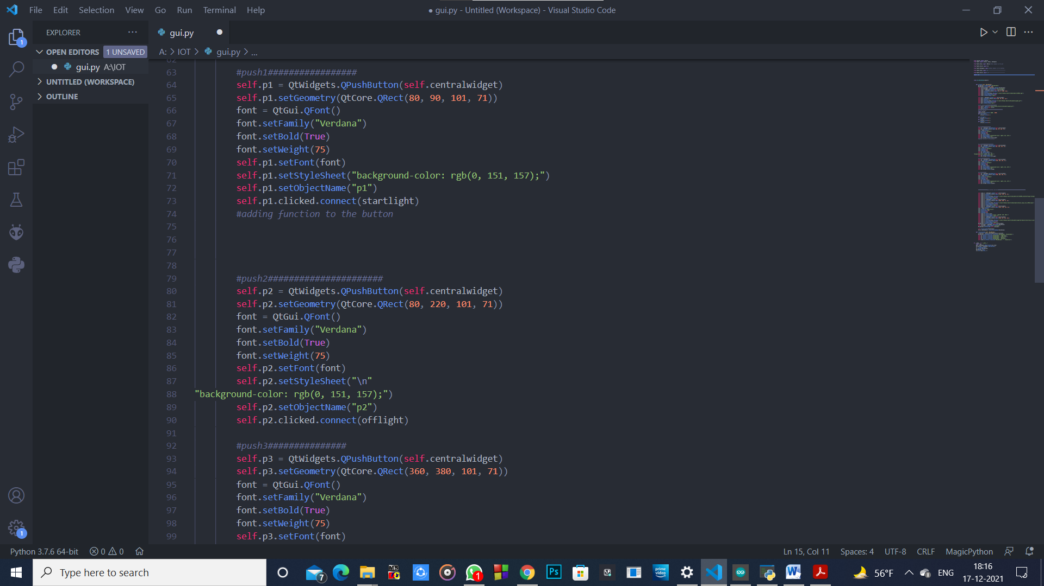
PUSH BUTTONS FOR THE GUI

Slide 15
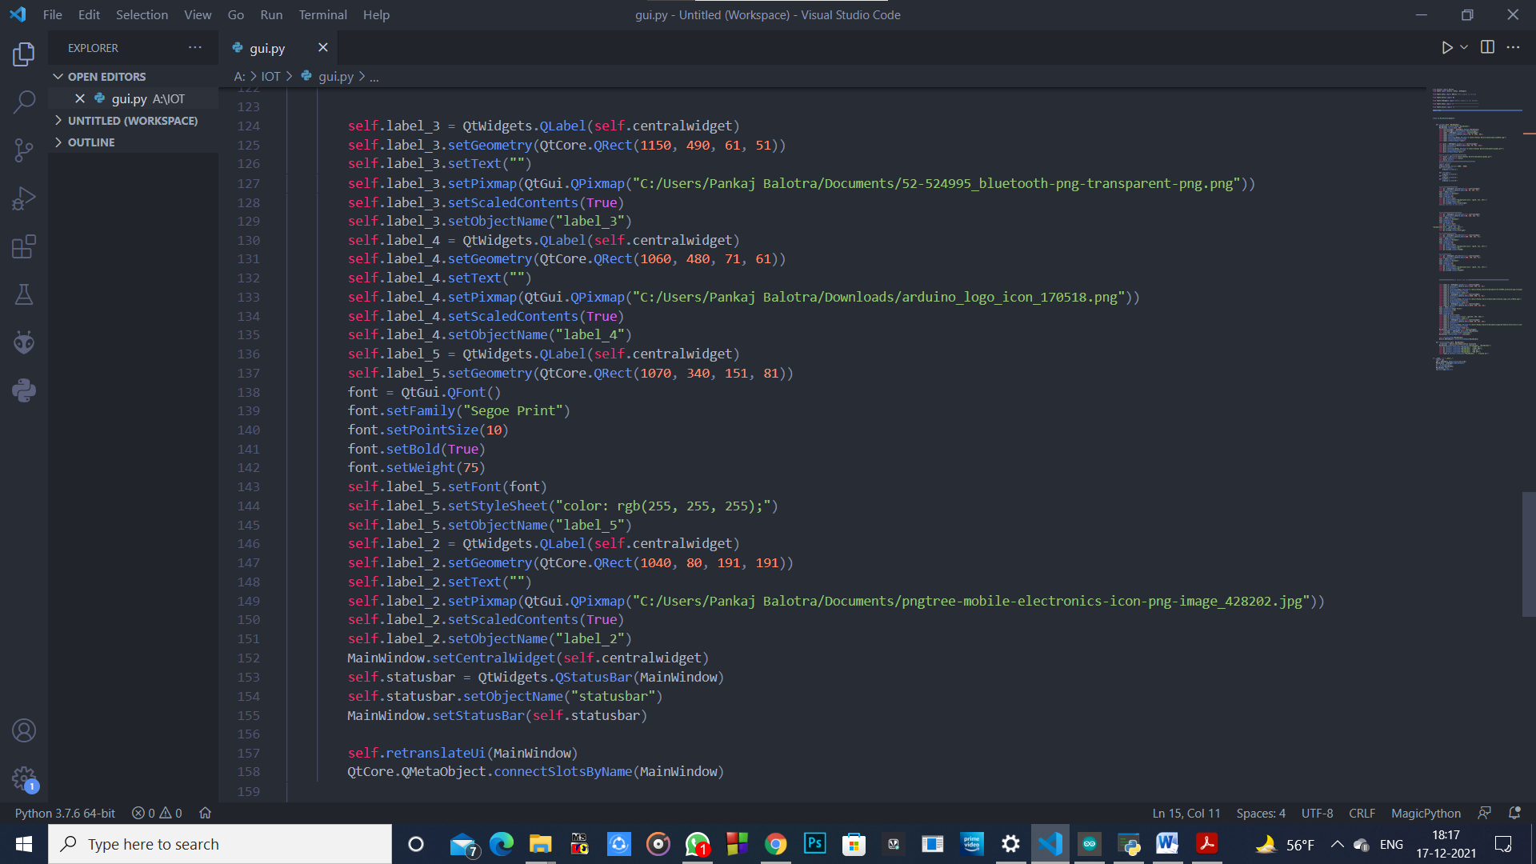

Slide 16
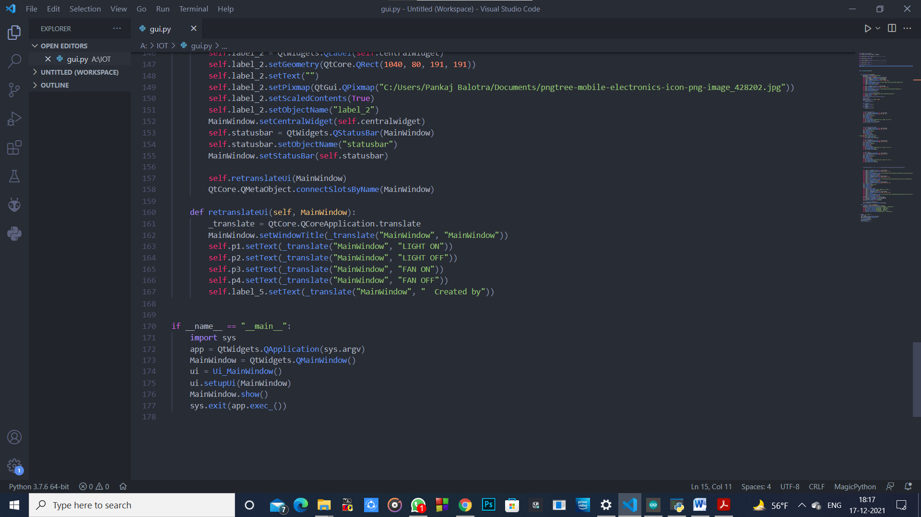
CODING ENDS HERE

Slide 17
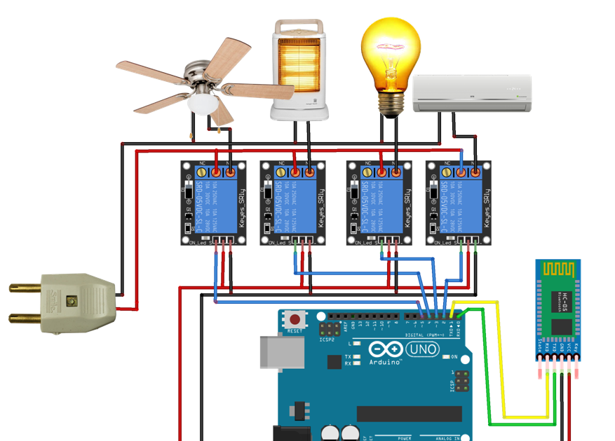
WORKING OF THE PROJECT

Slide 18
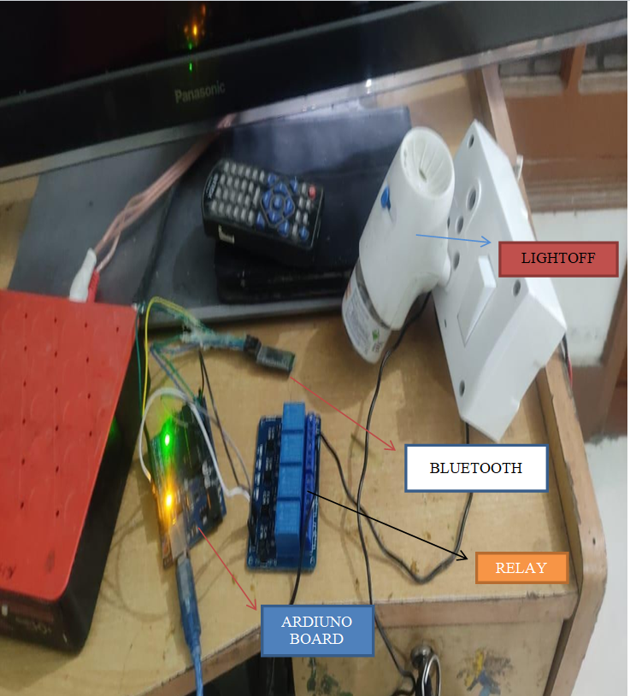
OUTPUTS OF MY PROJECT

Slide 19
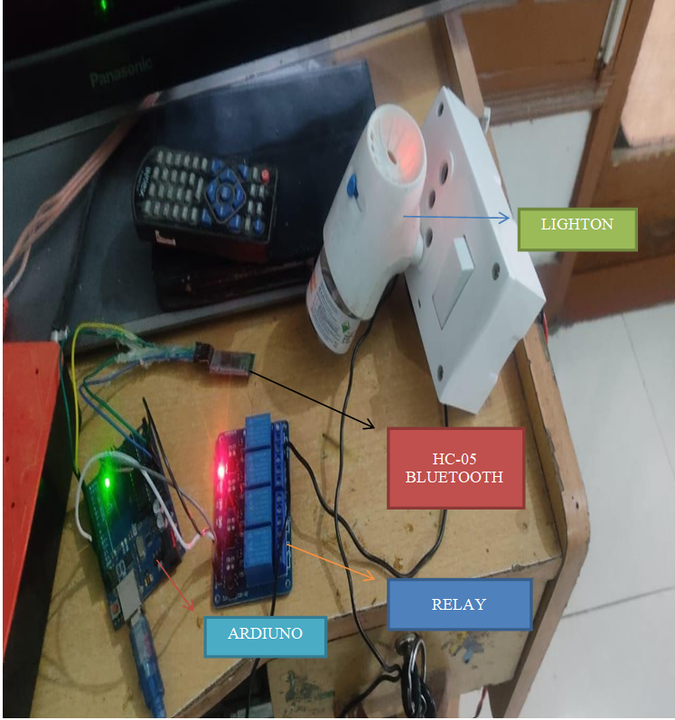

Slide 20
FEATURES AND ACTUATOR(SENSORS)
KEY FEATURES-
AVOID ELECTRIC SHOCKS.
TURN ON-OFF ANY APPLIANCE WIRELESSLY AND MORE SAFELY.
CAN BE HELP FULL FOR THOSE HUMANS WHO ARE PHYSICALLY CHALLENGED.
THIS PROJECT SHOWS THE CO-RELATION B/W PYTHON PROGRAMMING AND IOT.
THESE TYPE OF PROJECT CAN BE HELPFULL IN BUILDING MORE SKILLS OTHER THAN A SINGLE BRANCH FOCUSED
PROJECTS.
THESE TYPE OF PROJECT INCLUDES SOFTWERE KNOWLEDGE AS WELL AS HARDWERE KNOWLEDGE.

Slide 21
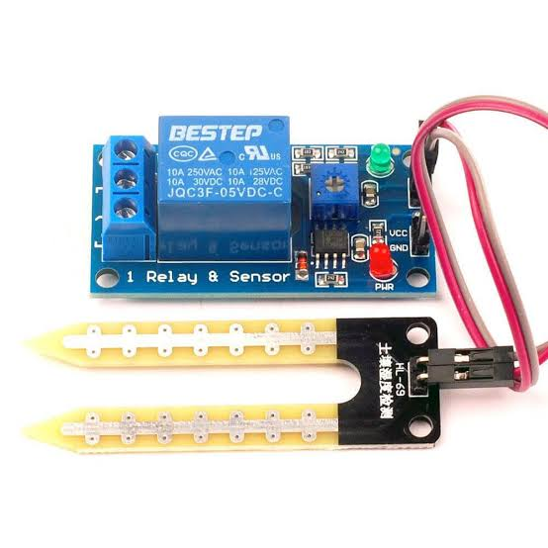
ACTUATOR USED IN PROJECT
SOIL SENSOR USED AS AN EXTRA FEATURE.

Slide 22
THANKS AND REGARDS
PANKAJ BALOTRA(CSE-FINAL YEAR)
UNIVERSITY ROLL-NO-1801271
(MAJOR PROJECT REPORT BY
STUDENT OF SARDAR BEANT SINGH STATE UNIVERSITY)
PROJECT COMPLETE DISCRIPTION
SUBMITTED TO – MR.LALIT KASHYAP

